Slide 1
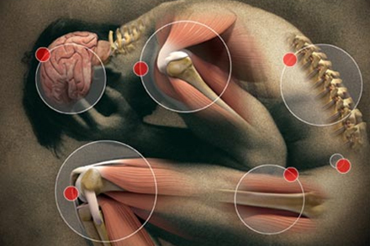
The Relation of Emotional Awareness to Fibromyalgia Symptoms
Kimberly A. Barchard¹, Heather Doherty², Caleb Picker¹, Jennifer Frazee¹, David A. Williams³, & Mark A. Lumley²
University of Nevada, Las Vegas
2. Wayne State University
3. University of Michigan

Slide 2
Fibromyalgia (FM) Symptoms
Widespread musculoskeletal pain
Fatigue
Memory problems
Attention problems
Hsu, Schubiner, Lumley, Stracks, Clauw, & Williams, 2010
Notes:
Fibromyalgia is a chronic condition that is characterized by wide-spread pain, fatigue and cognitive issues, such as memory problems and difficulty focusing and paying attention.

Slide 3
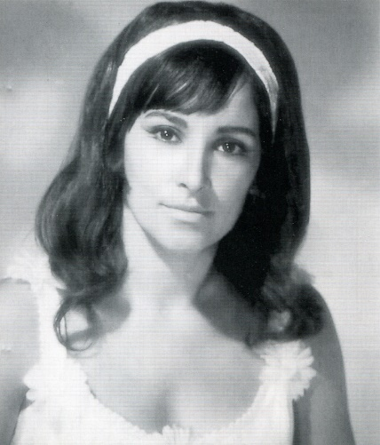
Fibromyalgia (FM) Symptoms
Sinead O’Connor
Rosie Hamlin
Mary McDonough
Walitt, Nahin, Katz, Bergman, & Wolfe (2015)
www.cnn.com
blog.backpainrelief.net
Michael James Hastings
Morgan Freeman
Notes:
It affects about 2% of adults. Symptoms can be minor or debilitating.
Walitt, B., Nahin, R.L., Katz, R.S., Bergman, M.J., Wolfe, F. (2015). The Prevalence and Characteristics of Fibromyalgia in the 2012 National Health Interview Survey. PLoS One; 10(9): e0138024.
https://www.cnn.com/2017/08/01/health/gallery/famous-people-with-fibromyalgia/index.html
http://blog.backpainrelief.net/the-west-wings-michael-hastings-on-fibromyalgia-part-ii/

Slide 4
Fibromyalgia (FM) Treatment
Pain relievers
Over the counter
Antidepressants
Anti-seizure drugs
Muscle relaxants
www.mayoclinic.org/
Notes:
Treatments focus on symptom management. Doctors prescribe pain relievers to reduce pain and fatigue, and muscle relaxants to promote sleep.

Slide 5
Fibromyalgia (FM) Treatment
Pain relievers
Over the counter
Antidepressants
Anti-seizure drugs
Muscle relaxants
Physical therapy
Occupational therapy
www.mayoclinic.org/
Notes:
Treatments also help patients with fibromyalgia live their lives to the fullest they can. Patients do physical therapy to improve their strength, flexibility, and stamina. And occupational therapy to make adjustments to their work areas to reduce stress on their bodies.
https://www.mayoclinic.org/diseases-conditions/fibromyalgia/symptoms-causes/syc-20354780

Slide 6
Fibromyalgia (FM) Causes
Pain receptors are overly sensitive
Neurotransmitters are out of balance
Deep phase of sleep is disrupted
www.mayoclinic.org
www.webmd.com
Van Houdenhove, Egle, & Luyten, 2005
Notes:
It is not known what causes fibromyalgia. Possible causes include pain receptors being overly sensitive, or neurotransmitters being out of balance. Another possibility is that the deep phase of sleep is disrupted.
https://www.mayoclinic.org/diseases-conditions/fibromyalgia/symptoms-causes/syc-20354780
https://www.webmd.com/fibromyalgia/default.htm
Van Houdenhove, B., Egle, U., & Luyten, P. (2005). The role of stress in fibromyalgia. Current Rheumatology Reports, 7,(5), 365-370. doi:10.1007/s11926-005-0021-z

Slide 7
Fibromyalgia (FM) Causes
Pain receptors are overly sensitive
Neurotransmitters are out of balance
Sleep disturbances
More common after:
Injury & surgery
www.mayoclinic.org
www.webmd.com
Van Houdenhove, Egle, & Luyten, 2005
Notes:
Fibromyalgia is more common after injuries or surgeries, which might explain why pain receptors are overly sensitive.
https://www.mayoclinic.org/diseases-conditions/fibromyalgia/symptoms-causes/syc-20354780
https://www.webmd.com/fibromyalgia/default.htm
Van Houdenhove, B., Egle, U., & Luyten, P. (2005). The role of stress in fibromyalgia. Current Rheumatology Reports, 7,(5), 365-370. doi:10.1007/s11926-005-0021-z

Slide 8
Fibromyalgia (FM) Causes
Pain receptors are overly sensitive
Neurotransmitters are out of balance
Sleep disturbances
More common after:
Injury & surgery
Trauma & stress
www.mayoclinic.org
www.webmd.com
Van Houdenhove, Egle, & Luyten, 2005
Notes:
Fibromyalgia is also more common after emotional trauma and stress. For example, high workload, low decision control, and bullying at work increase stress and also increase one’s risk of FM two- to four-fold. This hints to an emotional component to fibromyalgia.
https://www.mayoclinic.org/diseases-conditions/fibromyalgia/symptoms-causes/syc-20354780
https://www.webmd.com/fibromyalgia/default.htm
Van Houdenhove, B., Egle, U., & Luyten, P. (2005). The role of stress in fibromyalgia. Current Rheumatology Reports, 7,(5), 365-370. doi:10.1007/s11926-005-0021-z

Slide 9
Fibromyalgia (FM) Mood Issues
Often accompanied by depression and anxiety
Lumley et al., 2017
Van Houdenhove, Egle, & Luyten, 2005
Notes:
Furthermore, fibromyalgia is often accompanied by depression and anxiety.
Lumley et al. 2017
Van Houdenhove, B., Egle, U., & Luyten, P. (2005). The role of stress in fibromyalgia. Current Rheumatology Reports, 7,(5), 365-370. doi:10.1007/s11926-005-0021-z

Slide 10
Fibromyalgia (FM) Mood Issues
Often accompanied by depression and anxiety
Fibromyalgia Symptoms
Emotional Issues
Lumley et al., 2017
Van Houdenhove, Egle, & Luyten, 2005
Notes:
Researchers aren’t sure why depression and anxiety are so common. It might be that the pain and fatigue that accompanies fibromyalgia leads to anxiety and depression.
Lumley et al., 2017

Slide 11
Fibromyalgia (FM) Mood Issues
Often accompanied by depression and anxiety
Fibromyalgia Symptoms
Emotional Issues
CNS Circuits
Lumley et al., 2017
Van Houdenhove, Egle, & Luyten, 2005
Notes:
Alternatively, it might be that fibromyalgia sensitizes central nervous system circuits, which leads to difficulty processing and resolving emotional issues, and those difficulties lead to both somatic and psychological symptoms.
Van Houdenhove, B., Egle, U., & Luyten, P. (2005). The role of stress in fibromyalgia. Current Rheumatology Reports, 7,(5), 365-370. doi:10.1007/s11926-005-0021-z

Slide 12
Fibromyalgia (FM) Mood Issues
Emotion Awareness and Expression Therapy
Disclose stressors
Identify / express emotions
Weekly expressive writing
Express forgiveness / gratitude
Reduced widespread pain and overall FM symptoms
Emotions are central to FM
Lumley et al., 2017
Notes:
Given the frequency of emotional issues in fibromyalgia, researchers have examined the effectiveness of Emotional Awareness and Expression Therapy. Over a course of 8-weeks, fibromyalgia patients identify the things that cause them stress, identify how those stressors make them feel, and then express emotions they may be avoiding (such as anger, guilt, and love), using roleplaying and the empty chair technique. They also complete weekly expressive writing homework and are taught to express forgiveness and gratitude.
Emotional Awareness and Expression Therapy has been shown to reduce widespread pain and overall fibromyalgia symptoms. This suggests that emotional awareness may be a central feature of fibromyalgia.

Slide 13
This Study
Which aspects of emotional awareness are most closely related to FM symptoms?
Notes:
Given that emotional issues are central to fibromyalgia, the purpose of this research was to explore the relationship of fibromyalgia and various aspects of emotional awareness. We wanted to identify which aspects of emotional awareness are most closely related to fibromyalgia symptoms.

Slide 14
Method

Slide 15
Participants
Recruited from community for a study on FM treatments
Screening
Met criteria for FM according to 1990 or 2011 American College of Rheumatology criteria
Had FM as their primary issue
Spoke English
Could engage in group therapy
Were motivated to improve
Had no comorbid autoimmune disorders, history of serious mental illness, cognitive impairment, psychosis, suicidality, recent alcohol/drug dependence, pending or recent FM-related litigation or disability
757 people had telephone or in-person screening
230 met study criteria and were formed into 40 treatment groups
216 females, 14 males
Aged 20 – 74 (M 49.1, SD 12.2)
95% identified as White
Lumley et al., 2017
Notes:
230 patients with fibromyalgia were recruited from the community for a study on treatments for fibromyalgia. There were 216 females and 14 males.
The effectiveness of the FM treatments has been reported elsewhere. The current project examined the relationship of emotional awareness to FM symptoms using the pre-test data.

Slide 16
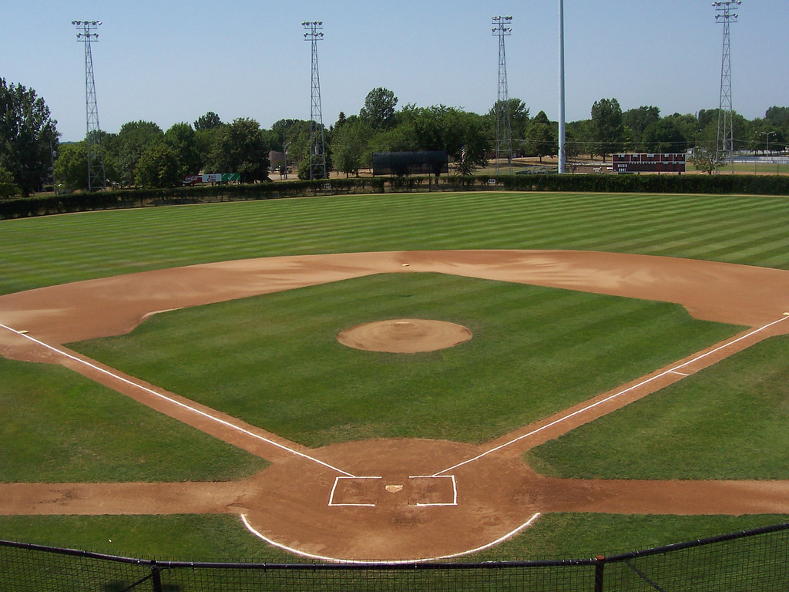
Measures
Levels of Emotional Awareness Scale
You slide into home base. The catcher touches you with the ball, but she is too late. You’ve scored a home run.
Notes:
To measure several different aspects of emotional awareness simultaneously, we used the Levels of Emotional Awareness Scale. In this test, people describe how they would feel in emotionally evocative situations. There’s another person mentioned in each situation, and they are also asked to describe how that person would feel.
For example, consider the following situation:
Imagine that someone wrote the following:
Each word in this response would be given a score.

Slide 17
Measures
Levels of Emotional Awareness Scale
You slide into home base. The catcher touches you with the ball, but she is too late. You’ve scored a home run.
I would feel happy and proud, but I’d also be in pain. I might cry. The catcher would be annoyed that I got the home run, but also worried if she thought I was hurt.
Notes:
To measure several different aspects of emotional awareness simultaneously, we used the Levels of Emotional Awareness Scale. In this test, people describe how they would feel in emotionally evocative situations. There’s another person mentioned in each situation, and they are also asked to describe how that person would feel.
For example, consider the following situation:
Imagine that someone wrote the following:
Each word in this response would be given a score.

Slide 18
Measures
Levels of Emotional Awareness Scale
You slide into home base. The catcher touches you with the ball, but she is too late. You’ve scored a home run.
I would feel happy and proud, but I’d also be in pain. I might cry. The catcher would be annoyed that I got the home run, but also worried if she thought I was hurt.
Notes:
Imagine that a someone responded the following way.

Slide 19
Measures
Levels of Emotional Awareness Scale
You slide into home base. The catcher touches you with the ball, but she is too late. You’ve scored a home run.
I would feel happy and proud, but I’d also be in pain. I might cry. The catcher would be annoyed that I got the home run, but also worried if she thought I was hurt.
0 Cognitions
Notes:
Words that represent cognitions are given a score of 0.

Slide 20
Measures
Levels of Emotional Awareness Scale
You slide into home base. The catcher touches you with the ball, but she is too late. You’ve scored a home run.
I would feel happy and proud, but I’d also be in pain. I might cry. The catcher would be annoyed that I got the home run, but also worried if she thought I was hurt.
0 Cognitions
1 Physical sensations
Notes:
Physical sensations are given a score of 1.

Slide 21
Measures
Levels of Emotional Awareness Scale
You slide into home base. The catcher touches you with the ball, but she is too late. You’ve scored a home run.
I would feel happy and proud, but I’d also be in pain. I might cry. The catcher would be annoyed that I got the home run, but also worried if she thought I was hurt.
0 Cognitions
1 Physical sensations
2 Actions related to emotions
Notes:
Actions related to emotions are given a score of 2.

Slide 22
Measures
Levels of Emotional Awareness Scale
You slide into home base. The catcher touches you with the ball, but she is too late. You’ve scored a home run.
I would feel happy and proud, but I’d also be in pain. I might cry. The catcher would be annoyed that I got the home run, but also worried if she thought I was hurt.
0 Cognitions
1 Physical sensations
2 Actions related to emotions
3 Specific emotions
Notes:
Finally, specific emotions are given a score of 3.

Slide 23
Measures
Levels of Emotional Awareness Scale
Emotional Specificity: Using precise emotion words rather than vague ones (happy vs. good)
Emotional Complexity: Using a variety of emotion words to describe your reaction to a scenario
Emotional Granularity: Using different emotion words to describe reactions to different scenarios
Emotional Verbosity: Using many words to describe emotional reactions
Overall Emotional Awareness
Hand scores
Highest-4
Highest-20 Unique
Barchard et al., 2011
Leaf & Barchard, 2013
Notes:
We used these word level scores to calculate 7 different measures of emotional awareness.
Emotional specificity is the tendency to use precise emotion words (like happy and worried) rather than vague words like good or bad.
Emotional complexity is the tendency to use a variety of emotion words to describe your reaction to a particular situation.
Emotional granularity is the tendency to use different words to describe your reactions to different situations. In one scenario you say you would feel happy and proud; in another, you say you would feel sad.
Emotional verbosity is the tendency to use a lot of words to describe your emotional reactions.
Finally, we calculated three different measures of overall emotional awareness.

Slide 24
Measures
Pain | Brief Pain Inventory (Cleeland, 2009)
Fatigue | PROMIS Fatigue (Cella et al., 2007)
Depression | CES-D (Randloff, 1977)
Anxiety | GAD-7 (Spitzer et al., 2006)
Sleep Quality | Pittsburg Sleep Quality Index (Buysse et al., 1989)
Quality of Life | Short-form Health Survey (Ware et al., 1996)
Life Satisfaction | Satisfaction with Life Scale (Diener et al., 1985)

Slide 25
Results

Slide 26
Sex Differences in Emotional Awareness
Emotional Awareness | Female Mean(SD) | Male Mean(SD) | t-test
Hand Scores | 29.88(5.20) | 30.49(6.50) | t(228) = 0.42, p = .674
Highest-4 | 69.56(20.19) | 75.29(23.05) | t(228) = -1.02, p = .309
Highest-20 Unique | 47.69(10.7) | 46.71(11.8) | t(228) = 0.33, p = .742
Specificity | 27.65(2.97) | 28.14(2.07) | t(228) = 0.61, p = .541
Complexity | 28.11(11.96) | 31.00(13.84) | t(228) = -0.94, p = .348
Granularity | 21.86(8.01) | 23.14(11.49) | t(228) = -0.57, p = .572
Verbosity | 262.53(155.95) | 337.86(229.37) | t(228) = -1.70, p = .091
Notes:
Men obtained higher scores than women on six of the seven measures of emotional awareness. However, due to the small number of men in this sample, none of these differences were statistically significant.

Slide 27
Correlations with Age
Emotional Awareness | Age
Hand Scores | -.20**
Highest-4 | -.20**
Highest-20 Unique | -.13
Specificity | -.12
Complexity | -.19**
Granularity | -.16*
Verbosity | -.04
Notes:
Contrary to previous research, older people had lower emotional awareness.
The negative correlations with age were statistically significant for four of the emotional awareness measures.

Slide 28
Correlations with FM
Emotional Awareness | Pain | Fatigue
Hand Scores | -.15* | -.09
Highest-4 | -.12 | -.09
Highest-20 Unique | -.19** | -.15*
Specificity | -.09 | -.14*
Complexity | -.12 | -.09
Granularity | -.15* | -.13*
Verbosity | -.06 | -.04
Notes:
Pain and fatigue were both related to emotional awareness. The remaining FM symptoms had small, non-significant relationships with emotional awareness.

Slide 29
Partial Correlations with FM
Emotional Awareness | Pain | Fatigue
Hand Scores | -.17* | -.11
Highest-4 | -.14* | -.11
Highest-20 Unique | -.21** | -.16*
Specificity | -.10 | -.15*
Complexity | -.14* | -.11
Granularity | -.17* | -.15*
Verbosity | -.06 | -.05
Notes:
When we controlled for age and sex, pain and fatigue were still related to emotional awareness. All of the previously significant relationships remained significant. In addition, two new relationships became statistically significant.
Pain was related to overall emotional awareness and to the ability to use a variety of emotion words. Fatigue was related to overall emotional awareness, the ability to use a variety of emotion words, and the tendency to use specific emotion words rather than vague ones. In all cases, more emotional awareness was related to lower pain and fatigue.
Surprisingly, pain and fatigue were unrelated to Emotional Verbosity. This was true both for the bivariate correlation and for the partial correlation. Verbosity generally has strong positive relationships with the other aspects of emotional awareness. Moreover, previous research has shown that the number of words a person uses to describe their emotions has as strong a relationship with criterion variables as the other emotional awareness measures.

Slide 30
Discussion

Slide 31
1. Relations with Age
Emotional Awareness correlated negatively with age.
Previous research has found positive correlations.
318 participants, 10-17 yrs, r = .06, p = .26
574 participants, 8-16 yrs, r = .19, p < .001
781 participants, 8-13 yrs, β = .09, p < .05 (controlling for sex)
Perhaps younger generations are more emotionally aware.
Perhaps FM decreases emotional awareness.
Future research should compare the emotional awareness of FM patients with age-matched controls, or examine the longitudinal effect of FM (and other types of chronic pain) on emotional awareness.
Notes:
Three main findings came out of this study.
First, Emotional Awareness was negatively correlated with age. All seven measures of emotional awareness had negative correlations with age, and four of these correlations were statistically significant.
This was surprising for two reasons. First, emotional awareness is theoretized to increase with age. As people age, they gain experiences with emotions and thus increase their emotional awareness. Second, previous research has found positive relationships between emotional awareness and age.
This current study differed from those previous studies in that our participants were older. They averaged 49 years and ranged in age from 20 to 74, with an average of 49 years. While previous studies compared people who were only a few years apart, this study compared people from different generations. Perhaps younger generations are more emotionally aware.
Alternatively, perhaps FM decreases emotional awareness.
Future research should compare the emotional awareness of FM patients with age-matched controls, or examine the longitudinal effect of FM (and other types of chronic pain) on emotional awareness.

Slide 32
2. Verbosity Unrelated to FM
Previous research has shown that the number of words a person uses to describe their emotions usually has as strong a relationship with criterion variables as the other emotional awareness measures.
However, in this study, pain and fatigue were unrelated to emotional verbosity. There were no significant relationships either for the bivariate correlations and for the partial correlations.
Emotional awareness and expression therapy is probably not effective just because it encourages people to talk about their emotions more.
Barchard, Bajgar, Leaf, & Lane, 2010
Barchard & Picker, 2017

Slide 33
3. Using the Right Words Relates to FM
Pain and fatigue were both negatively related to
the ability to use a variety of emotion words
Fatigue was also negatively related to
the tendency to use specific emotion words rather than vague ones
Emotional awareness and expression therapy decreases FM pain. Perhaps it works by increasing the ability to use a variety of emotion words to capture the precise emotion the patient is feeling.
Future research should examine how emotional complexity and granularity change over the course of treatment.
Lumley et al., 2017

Slide 34
Program for Open-Ended Scoring
Measures
Overall emotional awareness
Highest-4, Highest-20 Unique
Emotional Specificity
Emotional Complexity
Emotional Granularity
Emotional Verbosity
Provide the raw responses and a wordlist showing the scores for each word
Can be programmed to add new scoring methods
Freely available at https://github.com/deleaf/poes

Slide 35
Related Research
Friday 2:45 Poster Session
Factor Analysis of
Using exactly the right words to describe your emotion (precision)
Using a variety of words to describe your emotions (complexity and granularity)
Using many words to describe your emotions (verbosity)

Slide 36
Questions?
Contact:
kim.barchard@unlv.edu

